Slide 1
Bearcats Pantry Stocker Application

Slide 2
Overview
Purpose - the purpose of the stocker app is to make the Bearcats Pantry, providing food and hygiene products to students in need, more accessible through an online application where stock of items can be viewed and checked out by students. Administrators and volunteers at the pantry will also have access to important data to improve the pantry’s operations.
Goals
An online ordering systems where students can order products they need before arriving to the pantry in person.
An administrator dashboard with important data and reports to review and use to improve efficiency of the pantry.

Slide 3
Project Members
Abhinav Garg
Computer Science, gargav@mail.uc.edu
Derek Heidotting
Computer Science, heidotda@mail.uc.edu
Project Advisor - Samantha Groh

Slide 4
Project Abstract
The stocker application is a web application for students to use online before going to the pantry in person. A student is any student attending UC that can log-in through UC’s typical log-in page like in Canvas or Catalyst. A volunteer is anyone volunteering at the pantry, who may use the app to fulfill online orders and update stock, and use the app as in-person checkout. An administrator is any faculty member working at the pantry who can have access to data and reports regarding the pantry’s operations.

Slide 5
User Stories
As a student, I want to add desired products to a shopping cart and check out, so that I can receive the food and products I need to stay healthy.
As a volunteer at the pantry, I want to fulfill in-person and online orders with the stock of products updating for both, so that I know what products are in stock when I check the app.
As an administrator, I want to see which products are being purchased the most, so that the pantry can be more stocked with the most popular items and less stocked with the less popular items.

Slide 6
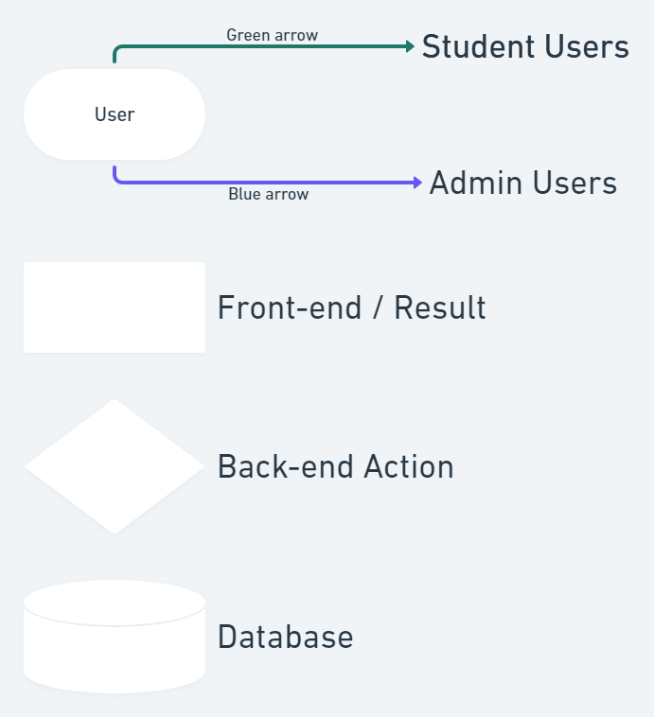
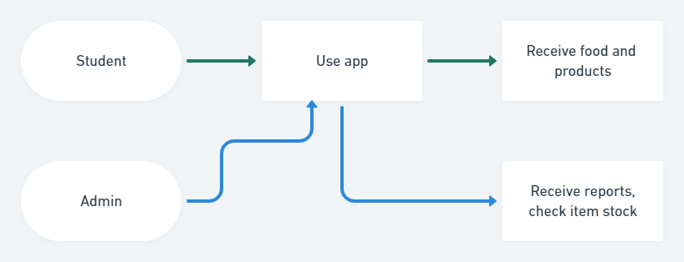
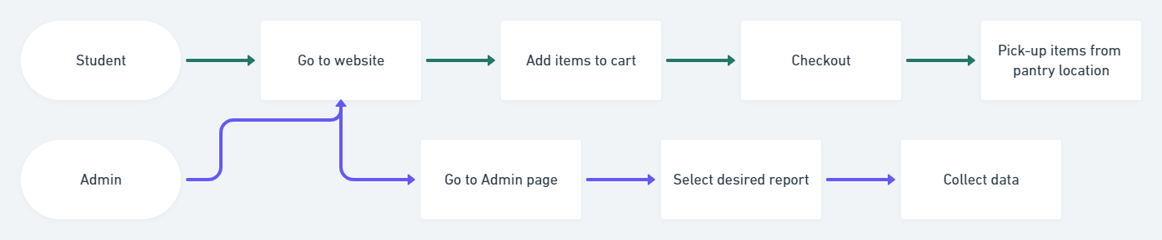
Design Diagrams #1 & #2
Legend

Slide 7
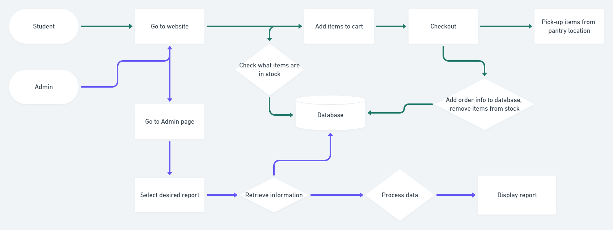
Design Diagram #3

Slide 8
Major Constraints
Time - there will be constraints on what capabilities can be added due to a limited amount of time. The team must organize the exisiting code before adding improvements to the app. There are certain features, like delivery capabilities, that will not be able to be completed in the two semesters of work. The team has prioritized the tasks needed to be done to have a working application for students to use. However, lower priority tasks like adding a search bar may not be completed.
Social - this app is to be used by the Bearcats Pantry organization to benefit students who need food and hygiene products but can't afford them. The Bearcats Pantry already benefits society in providing these products to students in need, and this stocker app will help BCP benefit the UC community even more. The BCP will be more accessible through this app. The leaders of BCP will be providing requirements for the app, therefore there are constraints on what the team would individually want to add.
Security - as a web app that uses students' UC credentials to login and use the app, there are security concerns to keep in mind. It will be very important to ensure students' personal information is not compromised in any way. Effort will be spent in security, constraining the amount of capabilities of the app that will be added.

Slide 9
Review of Progress
The app was a pre-existing senior design project from last year that had gone unfinished. It is not currently in use by the Bearcats Pantry. Much of the main functionality like adding items to a cart and checking out are in place, but further functionality must be added to be used. Also the admin page is not near completion.
The team is currently working on converting the code-base’s front end from plain HTML-CSS-JS to a React framework. This will allow further additions to the code to be much smoother and organized.

Slide 10
Expected Accomplishments by End of Fall 2021
Convert front end to React framework.
Create “out of stock” functionality
When a product runs out of inventory, it gets deleted and needs to be registered again.
Grouping of products by category
Allow students to sort items by category to narrow their search.
Data tracking of inventory coming in and going out

Slide 11
Division of Work
Organize and re-name files in the code-base into a new framework or easier use for the team. | 50% Abhinav, 50% Derek
Fix existing bugs in the checkout and orders page. | Derek 100%
Develop a log of actions made by admin users (approving orders, filling orders, adding inventory). | Abhinav 100%
Secure the existing security issue on the back-end of the project with UCIT. | Derek 100%
Customize delivery/pickup dates and times for busier hours or holidays. | Derek 100%
Develop an automated reporting system sent to admins every month. | Abhinav 100%
Design a filtering system of products in the inventory page. | Design a filtering system of products in the inventory page.
Develop the admin page further, displaying most important data at the top. | Abhinav 100%
Develop admin capability to send custom emails to students within the application. | Abhinav 70%, Derek 30%
Test with large dummy data for the admin page and reports. | Abhinav 80%, Derek 20%

Slide 12
Expected Demo at Expo
Allow guests to use the stocker app. Test out its functionality like sorting by category, adding items to cart, using a barcode scanner to view checkout process.
Possibly allow users to act as an administrator and use the admin dashboard. This is if the data isn’t too sensitive/private. Otherwise, visuals and reports of certain data will be displayed for people to see.

